Slide 1
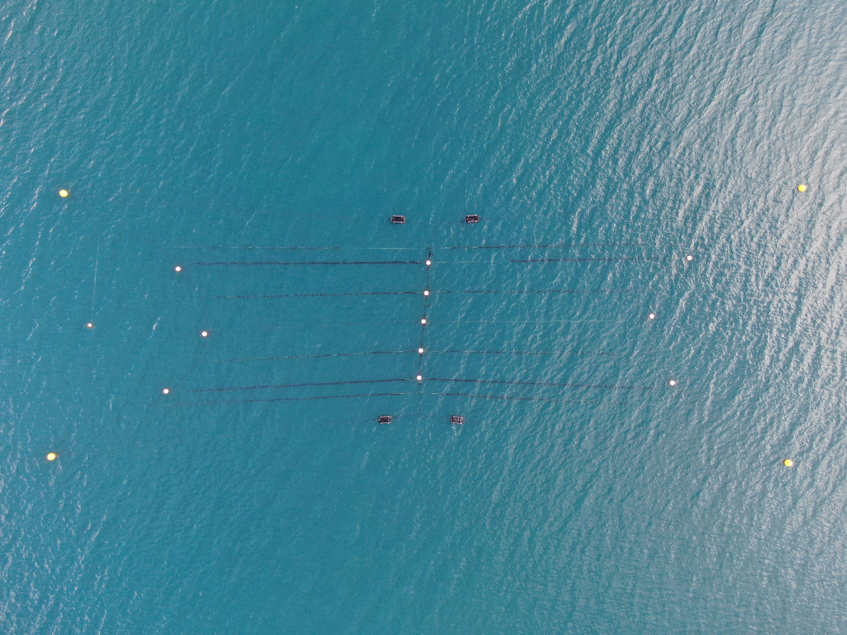

Biofouling prediction in seaweed aquaculture using plankton eDNA
Calum Young
1st year PhD student at University of Glasgow, Scotland

Slide 2

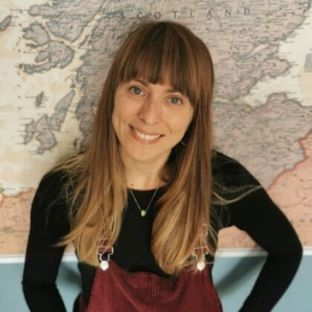
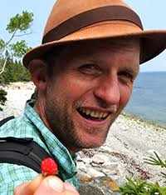
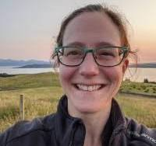
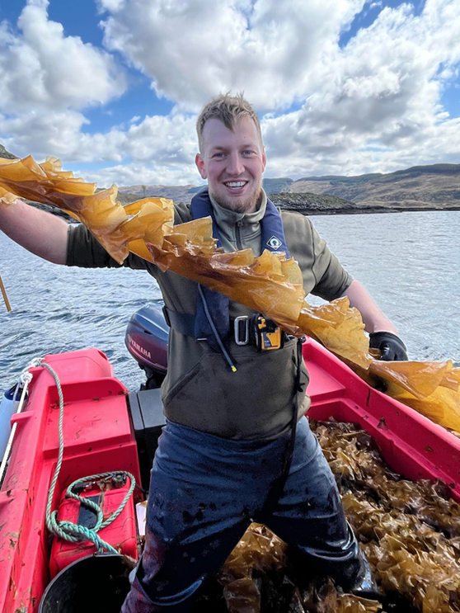

About me:
Calum Young
BSc (Hons) Freshwater and Marine Biology – University of Glasgow
MSc Marine Biology – Stockholm University
PhD Marine Ecology – UoG (Started November 2024)
Project Supervisors and Partners:
Dr Sofie Spatharis Prof Martin Llewellyn Dr Anna McGregor Marnik Van Cauter
UoG UoG UoG Kilchoan Melfort Trust
BBSRC 2023 Sustainable Aquaculture Partnerships for Innovation

Slide 3
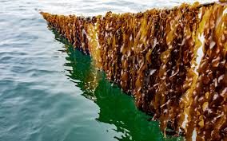
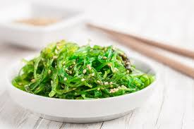
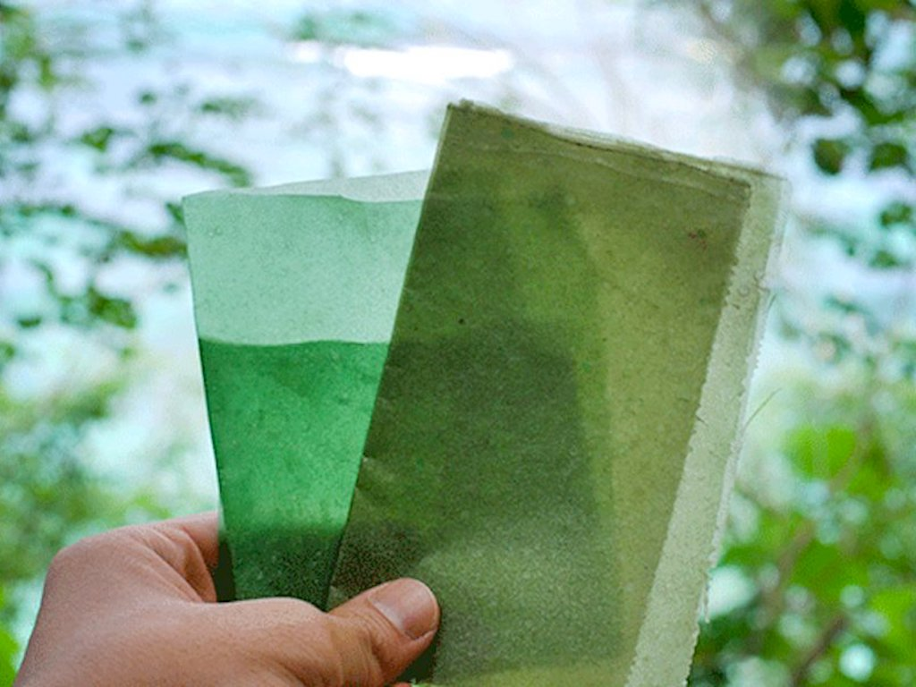
Expansion of Seaweed in Northeast Atlantic
Growing Demand Increasing : global food security, bioplastics, pharmaceuticals, textiles. . . .
Environmental Benefits : carbon sequestration, habitat restoration
Barriers to scaling up : storage, processing, supply chains

Slide 4
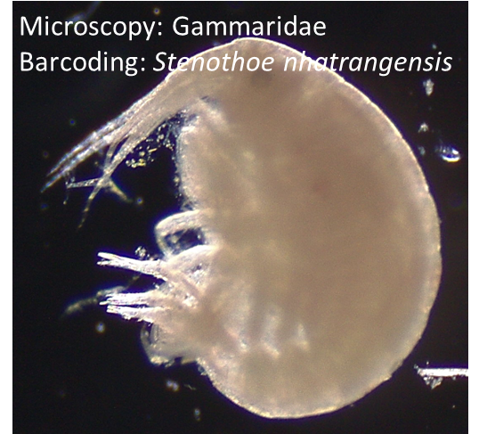
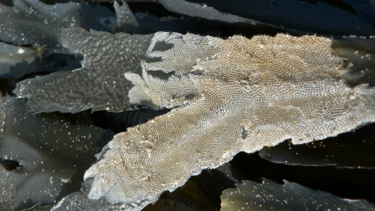
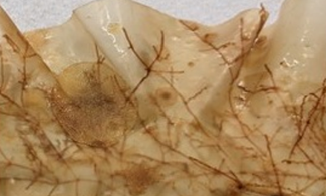
Limitations to seaweed farming expansion
BIOFOULING on seaweed crops
Bryozoans
Hydrozoans
Crustaceans
Gastropods
Epiphytic algae
Bryozoan mat : Membranipora membranacea
Image ref: 1
Hydrozoan (branches) and Bryozoan on Saccharina latissima
Image ref: 2,3

Slide 5
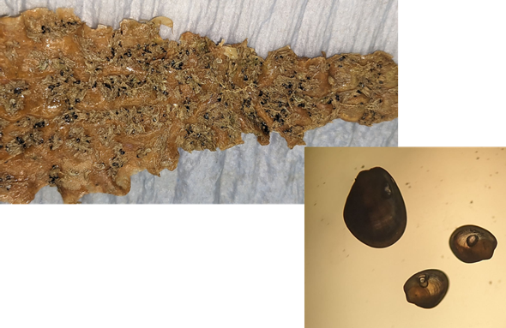
Biofouling impacts to seaweed farming
Physical damage : Increased weight and drag = breakage / dislodgment
Growth inhibition : Competition for light, nutrients, spore release, tissue necrosis
Economic losses : Reduced yield / quality / taste, increased allergen risks / increased processing time and labour costs
Bivalve infestation
Image ref: 4

Slide 6
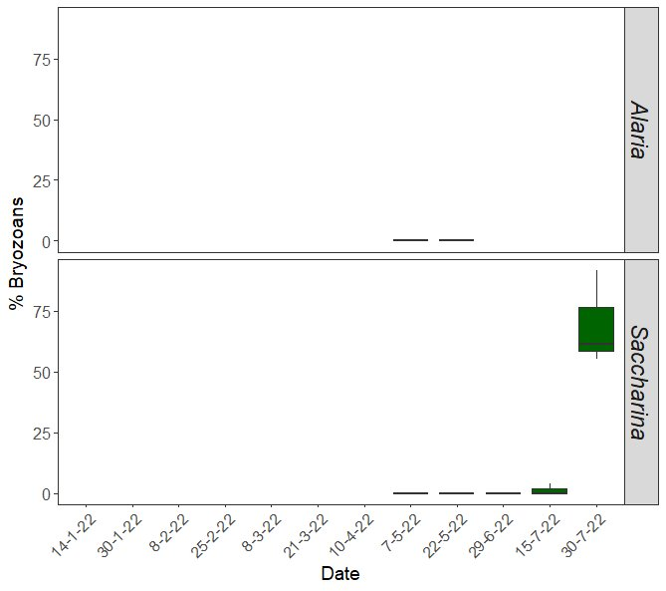
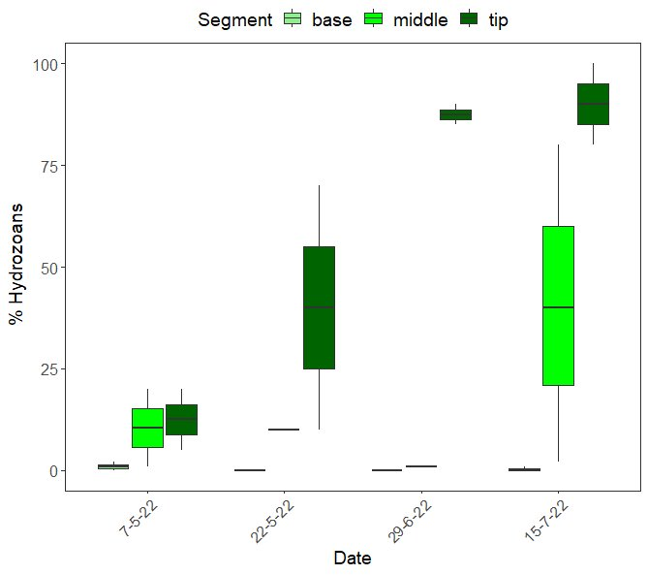
Biofouling rapidly increases in spring / summer
Bryozoan Coverage
Hydrozoan Coverage
Sofie Spatharis, KelpCrofting Pilot Study 2022

Slide 7

Project Aim
Monitored Abiotic Variables
Light
Temperature
Salinity
Hydrodynamics
Nutrients
Monitored Biotic Variables
Plankton microscopy + eDNA
Seaweed condition / growth
Epibiont coverage
Predictive model
Seaweed Biofouling
Epibiont type / species
Timing
Location
Large-scale spatial patterns

Slide 8
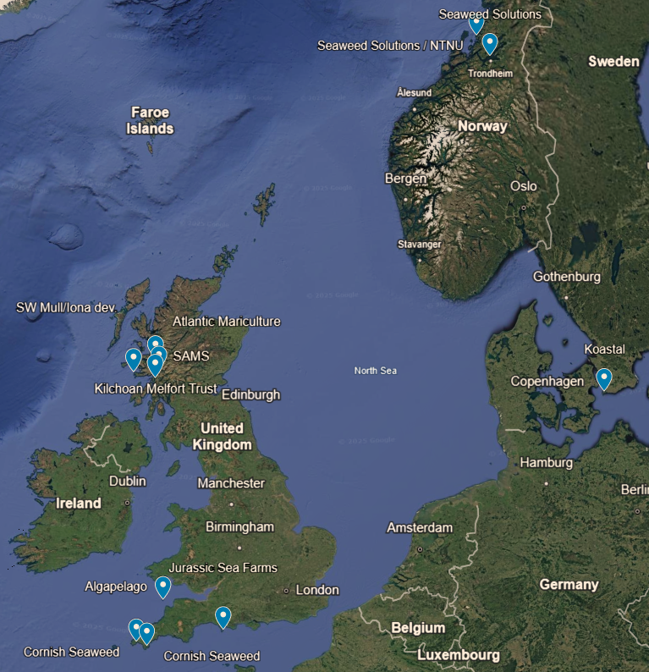
Sampling Farm Locations (n = 11)
Norway:
Seaweed Solutions / NTNU x 2
Sweden:
- Koastal
Scotland:
Kilchoan Crown Estate
Atlantic Mariculture
Scottish Assosciation of Marine Science (SAMS)
Southwest Mull and Iona Development
England:
Algapelago
Jurassic Sea Farms
Cornish Seaweed x 2
Sampling frequency:
Nov – March: monthly
April – August: bimonthly

Slide 9

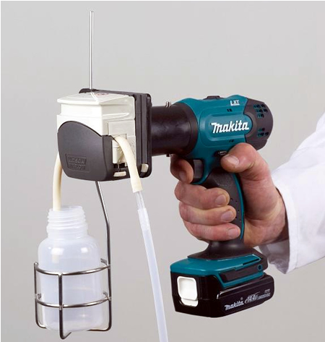
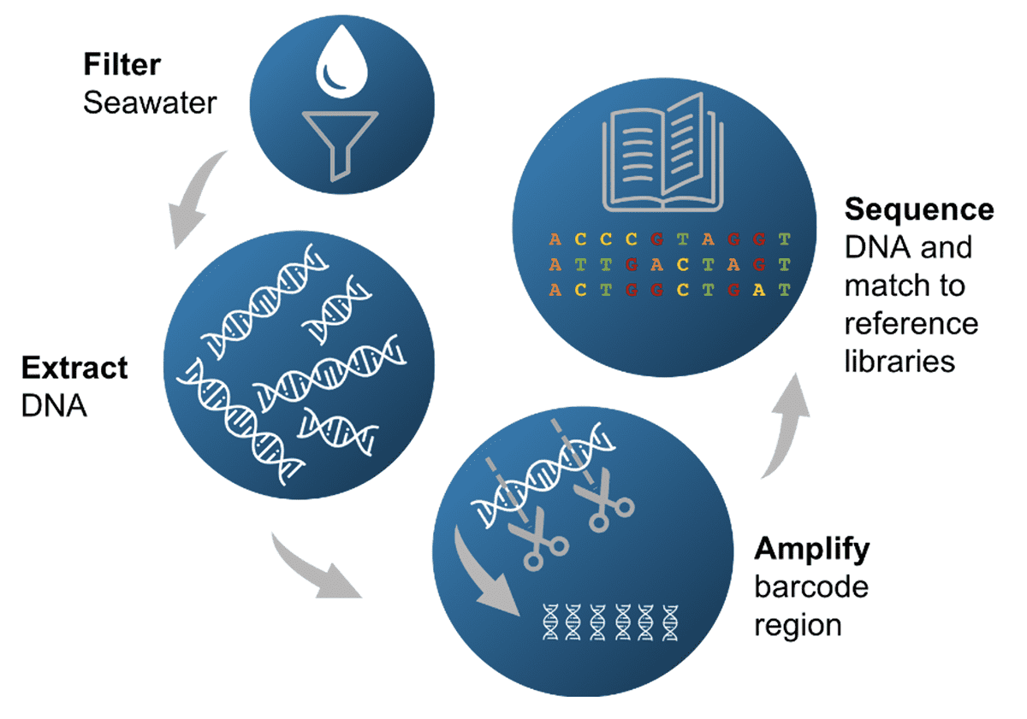
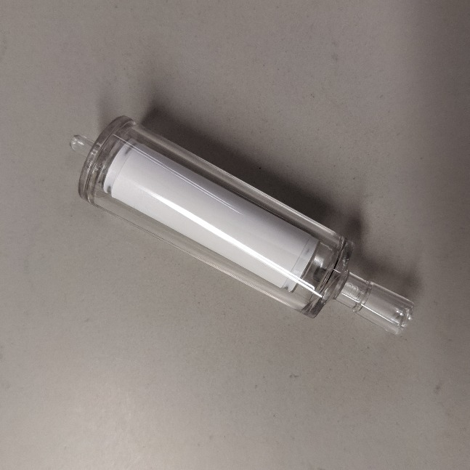
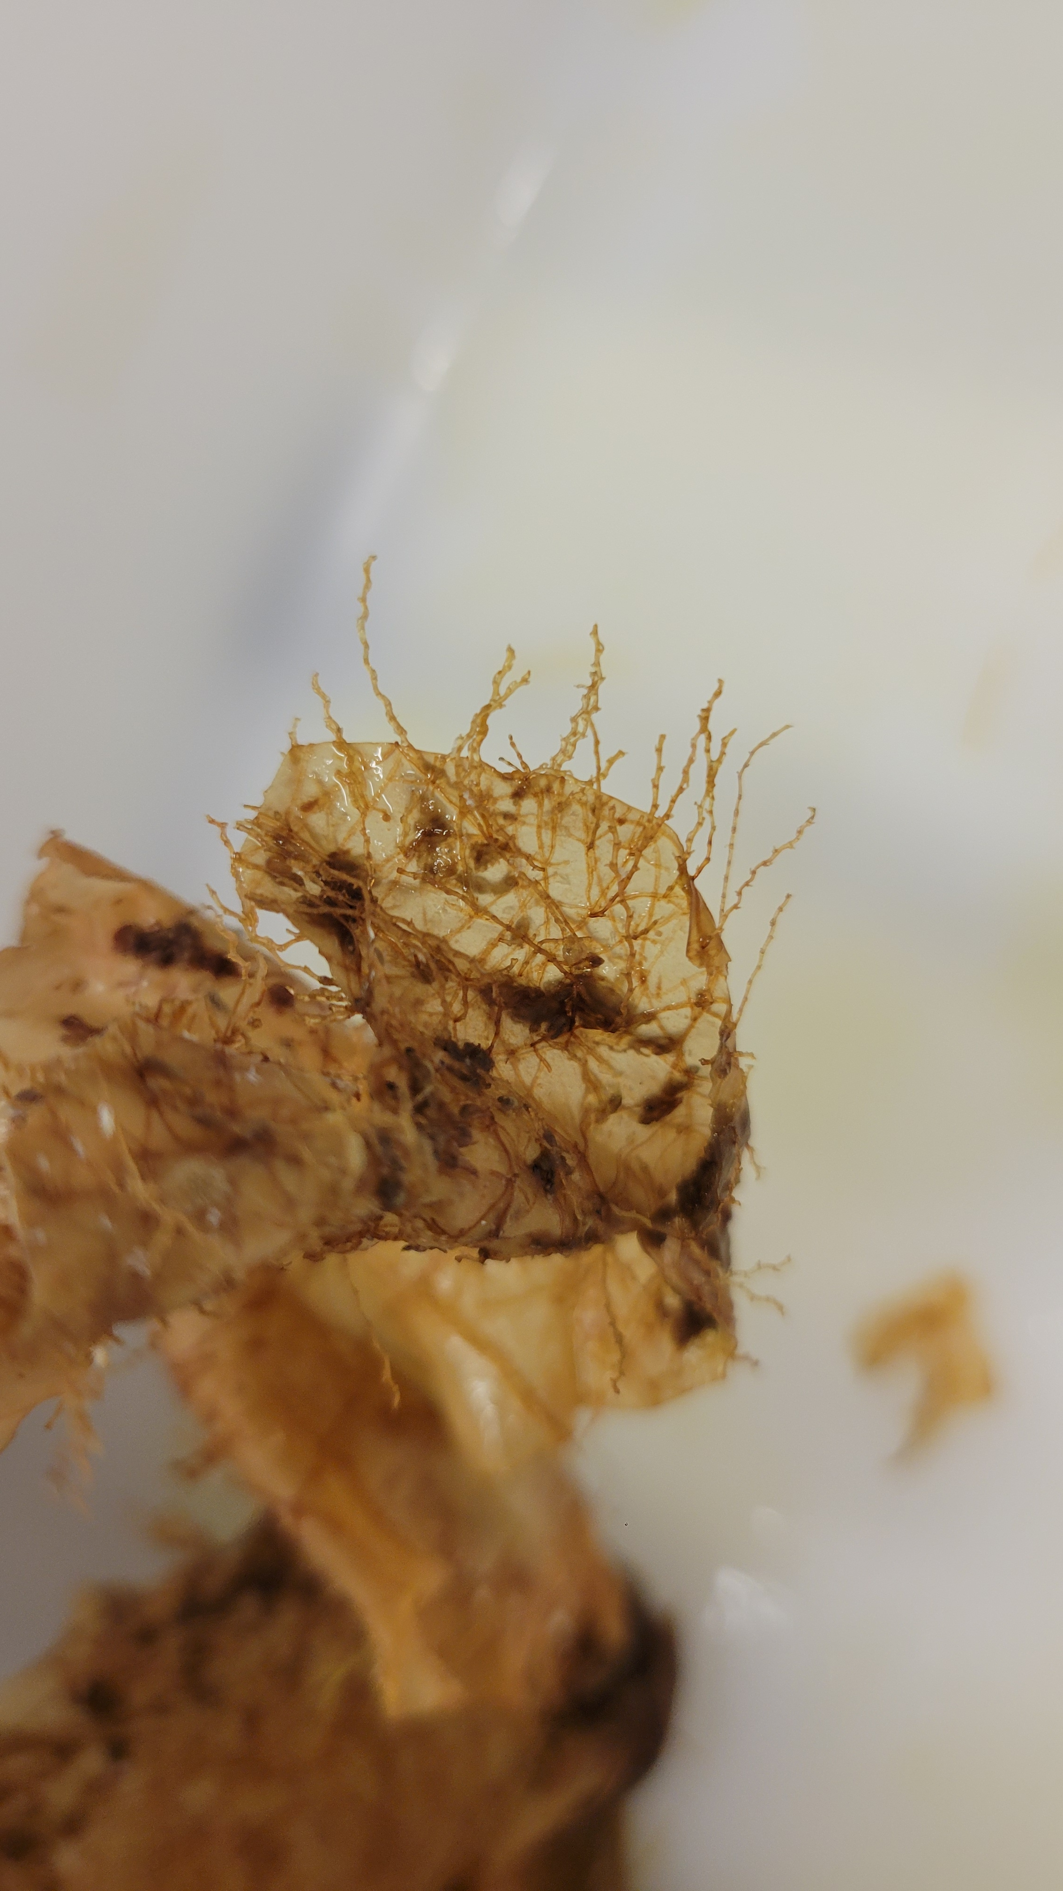
Sampling
Smart sensor buoy: abiotic
Vampire sampler + sterivex filter: plankton eDNA
Environmental DNA: genetic material released into environment by organisms: excretion, shedding, decay
qPCR, ddPCR
Visual Surveys
+ zoo / phytoplankton
+ phytoplankton
+ Blade Epibionts
+ water collection for nutrients
+ chlorophyll a

Slide 10
Research Questions
What are the main environmental drivers for biofouling presence/abundance, and how do these vary seasonally?
Assess environmental conditions factors across a broad spatial area throughout two growing seasons
Analyse temporal shifts in environmental conditions e.g. temperature, salinity, nutrient levels, and light to identify seasonal thresholds that influence biofouling dynamics (eDNA).

Slide 11
References
ALGUERÓ‐MUÑIZ, M., SPATHARIS, S., DWYER, T., DE NOIA, M., CHEAIB, B., LIU, YEE W., ROBERTSON, BRENDAN A., JOHNSTONE, C., WELSH, J., MACPHEE, A., MAZURKIEWICZ, M., BICKERDIKE, R., MIGAUD, H., MCGHEE, C., PRÆBEL, K. & LLEWELLYN, M. 2024. High‐Resolution Longitudinal eDNA Metabarcoding and Morphological Tracking of Planktonic Threats to Salmon Aquaculture. Environmental DNA, 6.
BANNISTER, J., SIEVERS, M., BUSH, F. & BLOECHER, N. 2019. Biofouling in marine aquaculture: a review of recent research and developments. Biofouling, 35, 631-648.
BUCKLIN, A., PEIJNENBURG, K. T. C. A., KOSOBOKOVA, K. N., O’BRIEN, T. D., BLANCO-BERCIAL, L., CORNILS, A., FALKENHAUG, T., HOPCROFT, R. R., HOSIA, A., LAAKMANN, S., LI, C., MARTELL, L., QUESTEL, J. M., WALL-PALMER, D., WANG, M., WIEBE, P. H. & WEYDMANN-ZWOLICKA, A. 2021. Toward a global reference database of COI barcodes for marine zooplankton. Marine Biology, 168.
FORBORD, S., MATSSON, S., BRODAHL, G. E., BLUHM, B. A., BROCH, O. J., HANDÅ, A., METAXAS, A., SKJERMO, J., STEINHOVDEN, K. B. & OLSEN, Y. 2020. Latitudinal, seasonal and depth-dependent variation in growth, chemical composition and biofouling of cultivated Saccharina latissima (Phaeophyceae) along the Norwegian coast. Journal of Applied Phycology, 32, 2215-2232.
WALLS, A. M., EDWARDS, M. D., FIRTH, L. B. & JOHNSON, M. P. 2017. Successional changes of epibiont fouling communities of the cultivated kelp Alaria esculenta: predictability and influences. Aquaculture Environment Interactions, 9, 57-71.

Slide 12
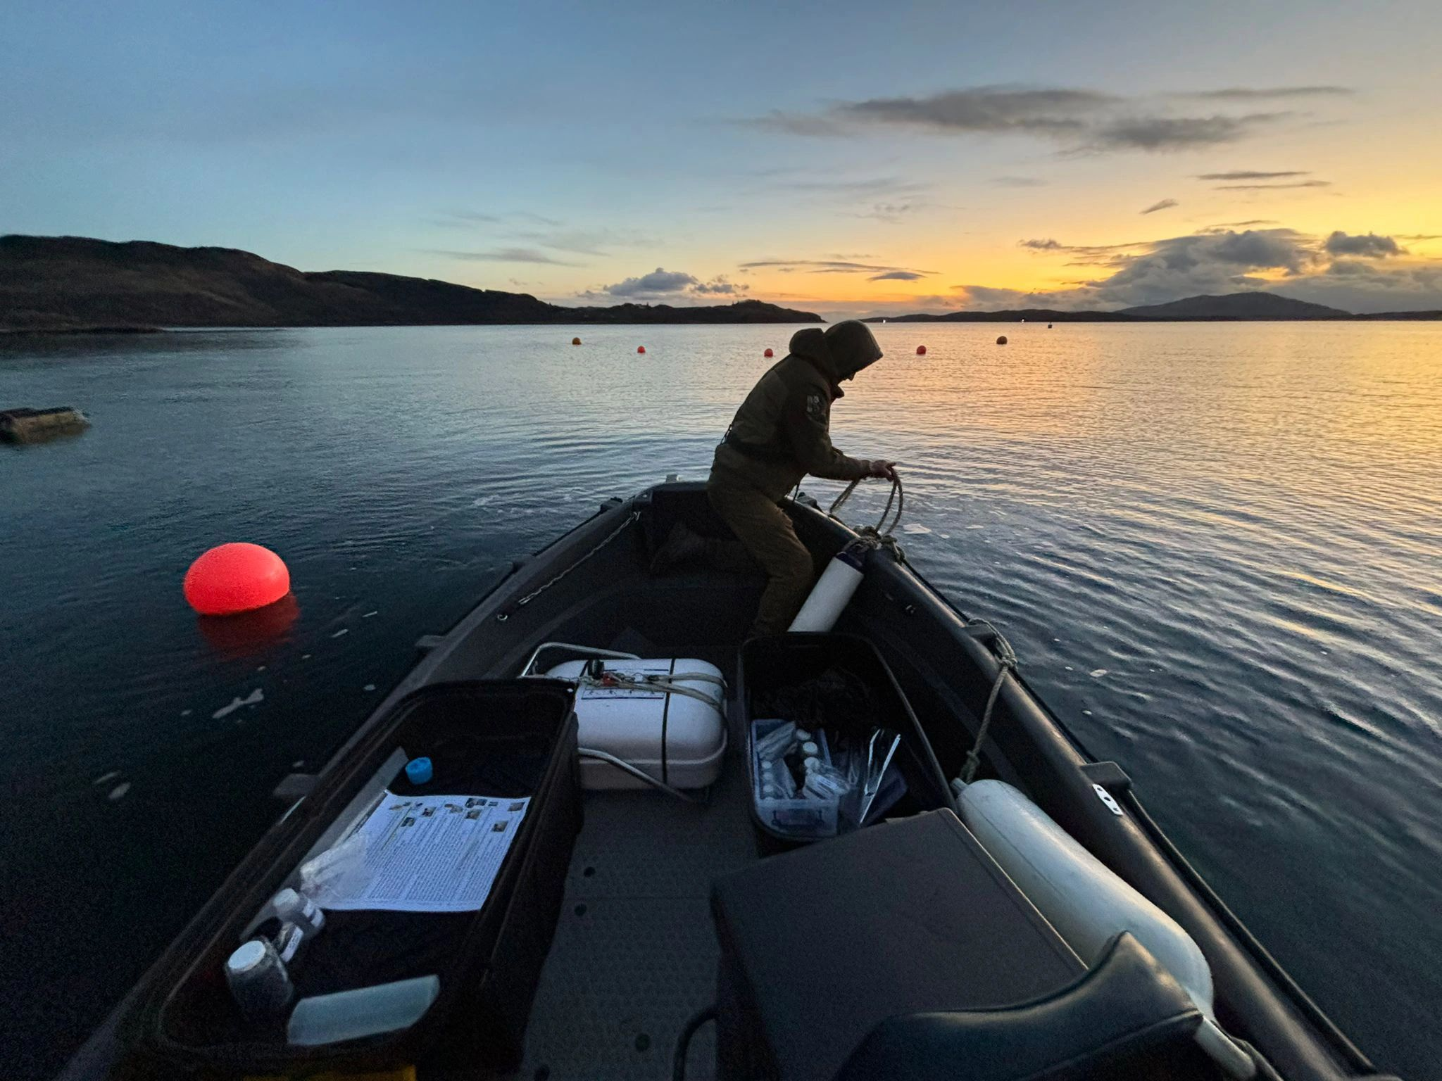
Thank you for listening
Calum Young
c.young.4@research.gla.ac.uk

